Slide 1

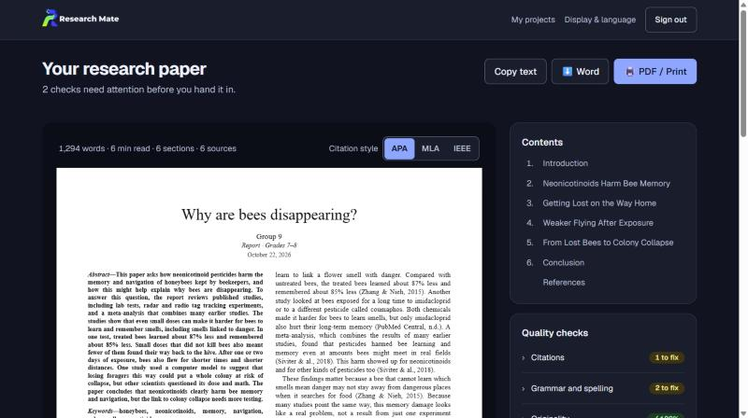
Research Mate
Turn a big question into research you're proud of
An AI research co-pilot for students, from Grade 4 to university
Mayo AI Bootcamp · Group 9
researchmate.online
Notes:
Welcome. We are [Team name], Group 9 of the Mayo AI Bootcamp, and this is Research Mate: an AI research co-pilot that helps students turn a big question into research they are proud of. It is live today at researchmate.online.

Slide 2
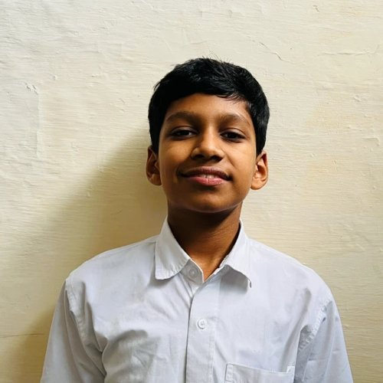
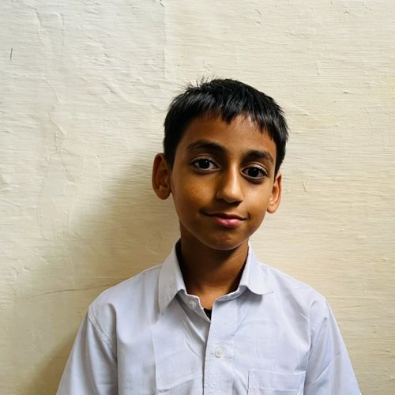
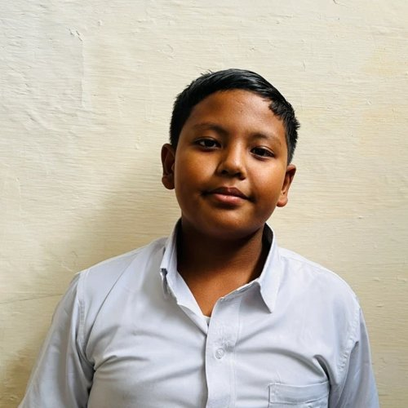
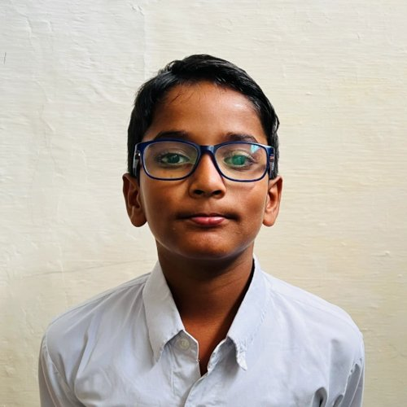
MEET THE TEAM
The people behind Research Mate
Atharva
Kabeer
Raj Shrestha
Raghubir
Leader
Researcher
Designer
Tester
Add one line about what they worked on.
Add one line about what they worked on.
Add one line about what they worked on.
Add one line about what they worked on.
Notes:
Introduce each team member and their role: Atharva, Kabeer, Raj Shrestha and Raghubir. (Fill in each person's role and one line about what they did.)

Slide 3



1 · PROBLEM STATEMENT
Great ideas, but no idea where to start
Students have marvellous ideas, yet research feels confusing and lonely.
Where do I even begin?
Turning a big idea into a clear research question is the hardest first step.
Information is everywhere
Facts are scattered across many websites and papers, and not all of them can be trusted.
No expert to ask
Most students don't have a researcher or mentor to guide them step by step.
Notes:
Set up the problem in one line: people have marvellous ideas but often don't know where to start. In our own school, many students had excellent ideas but couldn't work out how to research them. Information is scattered across websites and papers, and most students have no expert to guide them.

Slide 4
2 · STATISTICS
The gap in numbers
9%
96%
1 in 3
of 15-year-olds can reliably tell fact from opinion when reading online (OECD average)
of US high school students didn't question who was behind a website before trusting it
young people grow up without a mentor outside their family
OECD, PISA 2018
Stanford History Education Group, 2019
MENTOR, The Mentoring Effect, 2014
Sources: OECD, 21st-Century Readers (PISA 2018) · Breakstone et al., Students' Civic Online Reasoning (2019) · MENTOR, The Mentoring Effect (2014)
Notes:
Three numbers frame the gap.
1) On average across OECD countries, only 9% of 15-year-olds could reliably tell fact from opinion using cues in the text or source (OECD, 21st-Century Readers, 2021, based on PISA 2018): https://www.oecd.org/en/publications/21st-century-readers_a83d84cb-en.html
2) In a test of 3,446 US high school students, 96% did not consider why a website's funding by the fossil-fuel industry might affect its credibility (Stanford History Education Group, Students' Civic Online Reasoning, 2019): https://newslit.org/updates/study-students-show-troubling-lack-of-news-literacy-skills
3) One in three young people will grow up without a mentor outside their family (MENTOR, The Mentoring Effect, 2014): https://www.mentoring.org/resource/the-mentoring-effect/
Check each figure against the original publication before presenting.

Slide 5
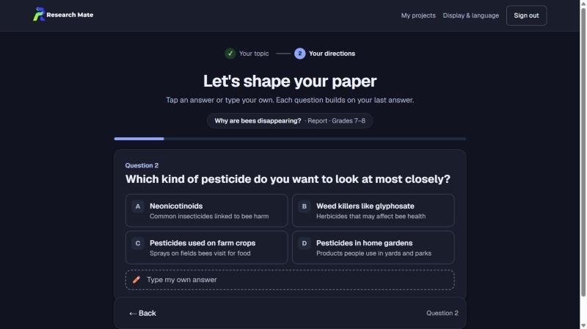



3 · OUR SOLUTION
Meet Research Mate, your research partner
Answer a few questions and it researches and writes a well-sourced paper that you can check and change.
A quick AI interview
Multiple-choice questions that shape your paper
AI does the research
Finds sources, takes notes, plans and writes it all
Sources you can trust
Every source is labelled Trusted, Check it or Be careful
Notes:
Our solution is Research Mate, an AI research partner. A student types their idea, picks what they are writing and their level, and then answers a short AI interview: multiple-choice questions, where each one builds on the last answer. From those answers Research Mate finds trusted sources, takes notes, plans the paper and writes it, and every source is labelled so students know what to trust. The student checks the plan before writing starts and can change anything afterwards.

Slide 6




4 · WHAT INSPIRED US
Every idea deserves a place to start
Ideas need a starting point
We saw that many students in our school had excellent ideas but couldn't think of how to research them or put them into practice.
Trust beats information overload
Guidance for everyone, not just a few
Group 9
Notes:
People have marvellous ideas but often don't know where to start. We saw that many students in our school had excellent ideas but couldn't think of how to research them or put them into practice. Research can feel confusing because information is scattered across many websites and papers, and most students don't have an expert to guide them. Keeping this in mind, we built a solution that is accessible to everyone: an AI co-pilot that helps people research and implement their ideas.

Slide 7
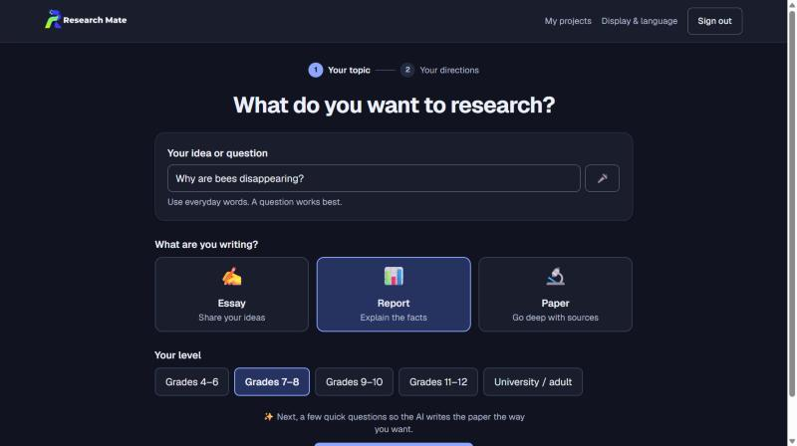
5 · HOW IT WORKS · START AND STEP 1
Share your idea, answer a few questions
S
Start
Type an idea, choose essay, report or paper, and pick your level
1
Interview
The AI asks multiple-choice questions, each built on your last answer
Notes:
Start: the student types their idea in everyday words, picks what they are writing (essay, report or paper) and their level, from Grade 4 to university. Step 1, Interview: the AI asks multiple-choice questions one at a time. Each question is built on the previous answer, for example which part of the topic, which group or place, and which effect to explore, and students can always type their own answer instead.

Slide 8
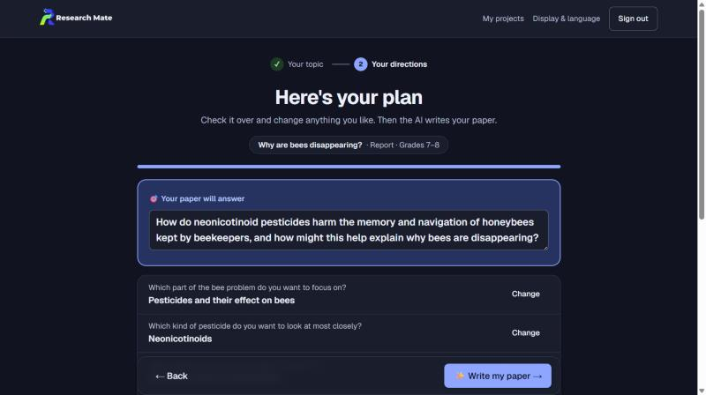
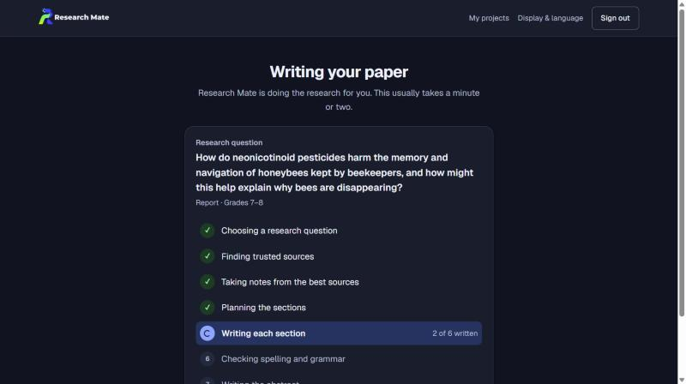
5 · HOW IT WORKS · STEPS 2 AND 3
Check the plan, let the AI do the research
2
Your plan
See the research question your answers add up to, and change any answer
3
AI research
Finds trusted sources, takes notes, plans and writes every section
Notes:
Step 2, Your plan: the answers add up to one clear research question, shown with every answer so the student can change any of them, along with paper length, the kind of sources and citation style. Step 3, AI research: Research Mate finds trusted sources on the web, keeps only the ones its searches really returned, takes notes from them, plans the sections and writes each one with citations, then writes an abstract.

Slide 9
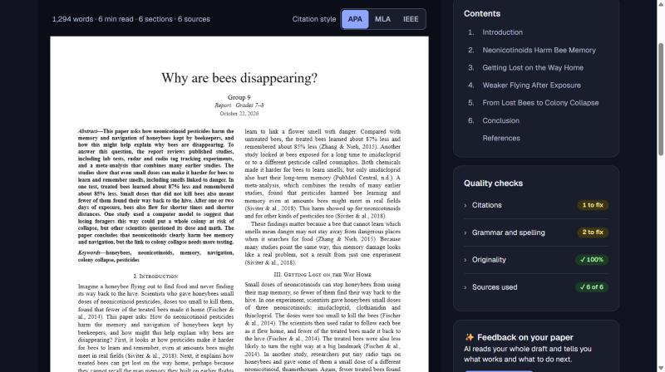
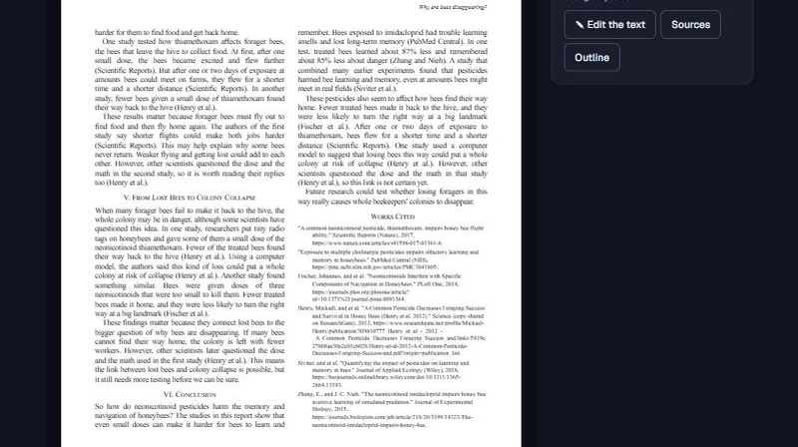
5 · HOW IT WORKS · STEPS 4 AND 5
A real research paper, ready to read
4
Paper view
Journal-style pages with an abstract, two columns and references
5
Your style
APA, MLA or IEEE: the citations and reference list change in one click
Notes:
Step 4, Paper view: the finished paper looks like a published article, with US Letter pages, a title block, an abstract and keywords, two justified columns, numbered headings, page numbers and a reference list. Step 5, Your style: switch between APA, MLA and IEEE, and both the in-text citations and the reference list change to match. PDF and print give exactly the same pages.

Slide 10

5 · HOW IT WORKS · STEP 6
Check your work before you hand it in
Originality
Flags sentences too close to a source
Citations verified
The Verification Agent checks each claim
Grammar and spelling
Catches mistakes before submission
Ready to hand in
APA, MLA or IEEE, to Word or PDF
Notes:
Step 6, Review: Research Mate checks originality, grammar and spelling, and the Verification Agent confirms each cited claim is supported by its source. Any problem can be fixed with one click. The paper exports in APA, MLA or IEEE style to Word, PDF or plain text.

Slide 11





6 · BENEFITS TO USERS
What students gain
Sources you can trust
Your answers shape it
Claims backed by evidence
Every source is labelled, with the reason why.
It follows your answers, and you can change any step.
Each cited claim is checked against its source.
Help that fits your level
Accessible by design
English and Hindi
Suggestions adapt from Grade 4 to university.
Read aloud, voice typing, larger text and high contrast.
Use the whole app in the language you think in.
Notes:
Six benefits: trustworthy sources, a paper shaped by the student's own answers, claims checked against evidence, help pitched at their level, accessibility features, and the whole app in English or Hindi.

Slide 12



7 · SOCIETAL IMPACT
Helping every student research well
Equal access
Quality research guidance in English and Hindi, with accessibility built in.
A research partner for anyone with a browser
Not only for students who already have a mentor, a library or a researcher in the family.
Smarter about information
Students learn to spot trustworthy sources and question what they read online.
Transparent work
Every fact is cited and checked against its source, so students see where it came from.
Notes:
The wider impact: research help for any student with a browser, better information literacy at a time of online misinformation, and transparent work, because every fact is cited and checked against its source. Add any school feedback or pilot results here when you have them.

Slide 13




8 · HOW WE BUILT IT
A modern web stack with AI at the core
Front end
Next.js 16, React 19 and Tailwind CSS
AI
Claude through Vercel AI Gateway, with web search and Zod-checked answers
Accounts and data
Supabase sign-in with email verification; each student's work kept private
Hosting
Deployed on Vercel at researchmate.online
Six cooperating AI agents
Interviewer
Source Discovery
Outline Builder
Writing Partner
Editor
Verification
Built step by step with Claude Code and tested with Vitest.
Notes:
Walk through the stack: Next.js, React and Tailwind on the front end; Claude through Vercel AI Gateway for the AI, with web search so sources are real and Zod schemas so every answer has the right shape; Supabase for sign-in with email verification and row-level security so nobody can see another student's work; hosted on Vercel. Six agents cooperate: the Interviewer asks the questions, Source Discovery finds sources, the Outline Builder plans the sections, the Writing Partner drafts them, the Editor writes the abstract, and Verification checks every cited claim. We built it step by step with Claude Code.

Slide 14



9 · HOW WE WANT TO GROW IT FURTHER
Next steps for Research Mate
NEXT
SOON
LATER
Smarter agents
Reach more people
Everywhere you learn
More academic databases, better document analysis, and agents that work together to verify evidence and spot research gaps more reliably.
More languages, voice interaction, offline access to saved research and even better accessibility for users with disabilities.
Mobile apps, and partnerships with schools, universities and research institutions.
User feedback will guide every change, keeping Research Mate affordable, inclusive and useful.
Notes:
In the future we aim to integrate more academic databases, add multilingual support and improve document analysis. We plan to make our specialised AI agents collaborate more effectively, verify evidence more accurately and identify research gaps more reliably. Additional features could include voice interaction, offline access to saved research and improved accessibility. We also hope to build mobile apps and work with schools, universities and research institutions. User feedback will guide improvements, so the platform stays affordable, inclusive and useful.

Slide 15
Thank you
Try it at researchmate.online
Questions?
Notes:
Thank you. Research Mate is live at researchmate.online, so please try it. We are happy to take questions.

